Slide 1
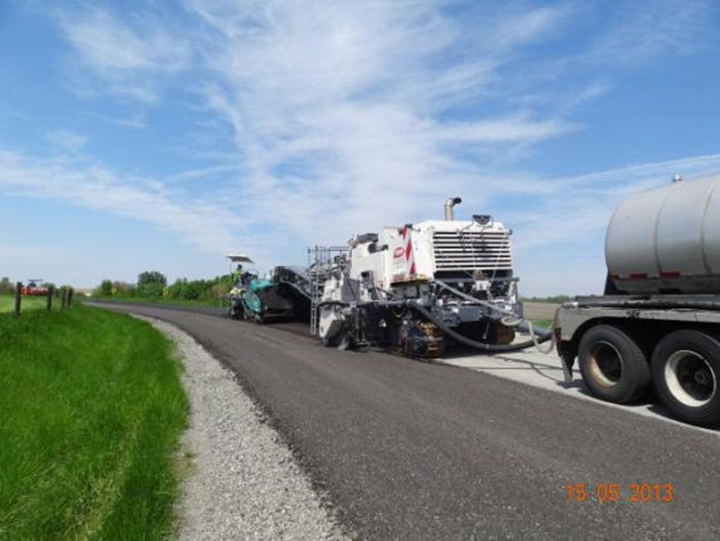
Full Depth Reclamation (FDR) using Cement Stabilization and Additive [Acceptance criteria of Commercial Chemical Stabilizer(CCS)- Additive]
Uttar Pradesh Rural Road Development Agency

Slide 2
The SBD of FDR States about the acceptance of additive as follows:
The stabilizer/Additive/Commercial Chemical Stabilizer's acceptability is to be examined in light of the provisions in MoRTH circular dated 14.12.2020 and IRC SP-89 (Part-II)-2018, important parts of which are as follows:
The clause 8.3 and 09 of the circular dated 14.12.2020 of MoRTH state that-

Slide 3
8.3- It is clarified that any new alternate, material & technology that has been accredited by IRC, and falling under IRC: SP-89(Part II), will not require further accreditation, and will henceforth fall under approved, alternate, material and technologies.
9- It is clarified that the material /technology for which Codes, Standards, Specifications, Guidelines etc. of IRC, MoRTH, AASHTO, ASTM, Euro Code and British Codes are available shall not be treated as new / alternate material / technology.
The stabilizer/Additive/Commercial Chemical Stabilizer's must be accredited by IRC or equivalent organizations, as mentioned above.

Slide 4
Prerequisites for Acceptance of CCS (Additive)

Slide 5
The job mix design is an important factor for FDR. This varies with soil type also. So, the company bidding for the FDR Project, if does not have its own additive, will be required to have an agreement with the additive company either prior or post to bidding.
If contractor opts to have an agreement with the additive company post to bidding, then the contractor will have to submit the said agreement as per direction of employer.
The Additive Company should have experience in the field of road construction using New Technology “Full Depth Reclamation (FDR) in-situ stabilization with cement stabilization and additives”, either in India or Outside India. It will have to support for mix design, execution and supervision of the soil stabilized layer

Slide 6
The PIUs should seek the following details of additive from the contractor/additive supplier:
Brand Name of the Additive
Manufacturer Name of Additive
Manufacturer Address, Email Id and Contact Number
Physical Form of Additive
Whether Liquid, Granular or Powder form
Status of Accreditation (Whether IRC or as per MoRTH)

Slide 7
Status of Accreditation (Whether IRC or as per MoRTH – AASHTO, ASTM, Euro Code or British Code)
Proof of Accreditation
Toxibility/Leaching Test Report

Slide 8
As success of the FDR depends on the judicious selection of the Additive, the Additive should be accepted carefully which is likely to be used in reclamation.

Slide 9
THANK YOU

